Slide 1
OXYGEN ISOTOPES
To be used only for scholarly purposes,
consistent with “fair use” as prescribed in the U.S
B.C. Schreiber
U. Washington
Dept. Earth & Space Science

Slide 2
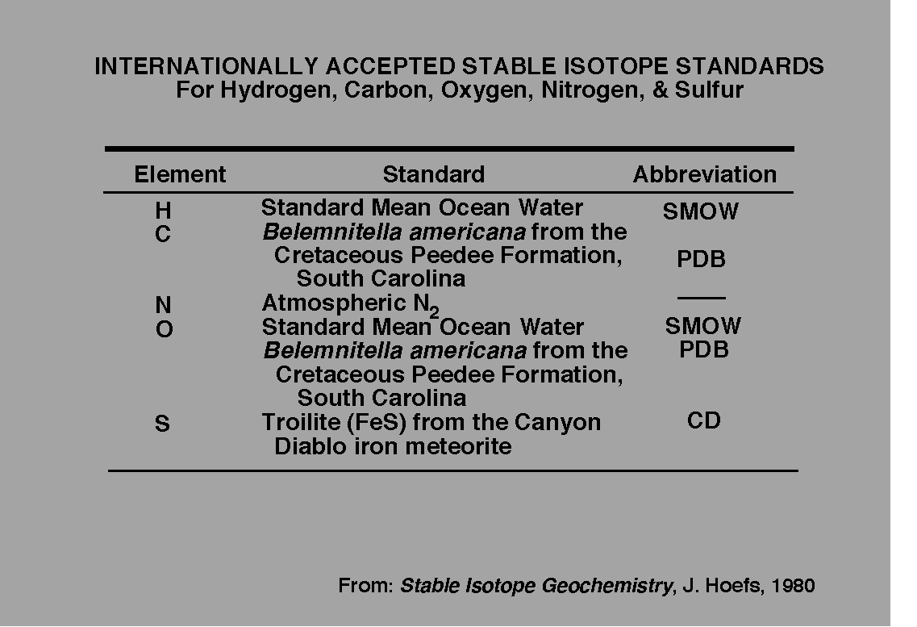
Standards Vary

Slide 3
Oxygen isotope chemostratigraphy
Relative concentrations (stable isotopes):
¹⁶O = 99.76%
¹⁷O = 0.38%
¹⁸O = 0.21%
Urey and Emiliani (1947) discovered that oxygen
isotopes fractionate, depending largely on temperature.
They examined shells of foraminiferans
throughout the Pleistocene and
O isotopes in the shells appeared
to respond to the temperature changes
associated with the ice ages, with
oceanic sediments becoming isotopically
heavy during glaciations and lighter
during warming.
OXYGEN ISOTOPES

Slide 4
BUT
Normally, when when water evaporates, molecules with ¹⁶O more readily
enter the vapor phase. Typically this makes no difference as the water
soon condenses and is back in the oceans.
The same principle applies to atmospheric water. Condensation preferentially
draws H₂¹⁸O out of the atmosphere. Results in ¹⁶O-rich (or ¹⁸O-depleted)
polar snow.
During times of high glacial activity, ocean waters are very enriched in ¹⁸O
Organisms that incorporate oxygen-bearing molecules (such as CaCO₃)
into shells or bones will also be enriched in ¹⁸O. Therefore, a δ¹⁸O curve is
a direct result of ice volume.
So the δ¹⁸O curve is a fairly good proxy for temperature changes

Slide 5
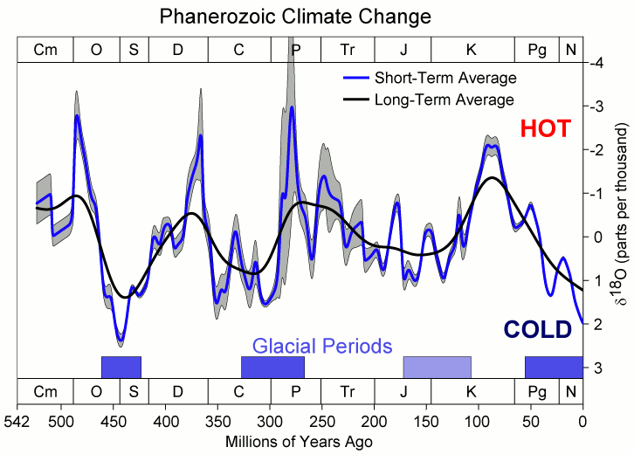

Slide 6
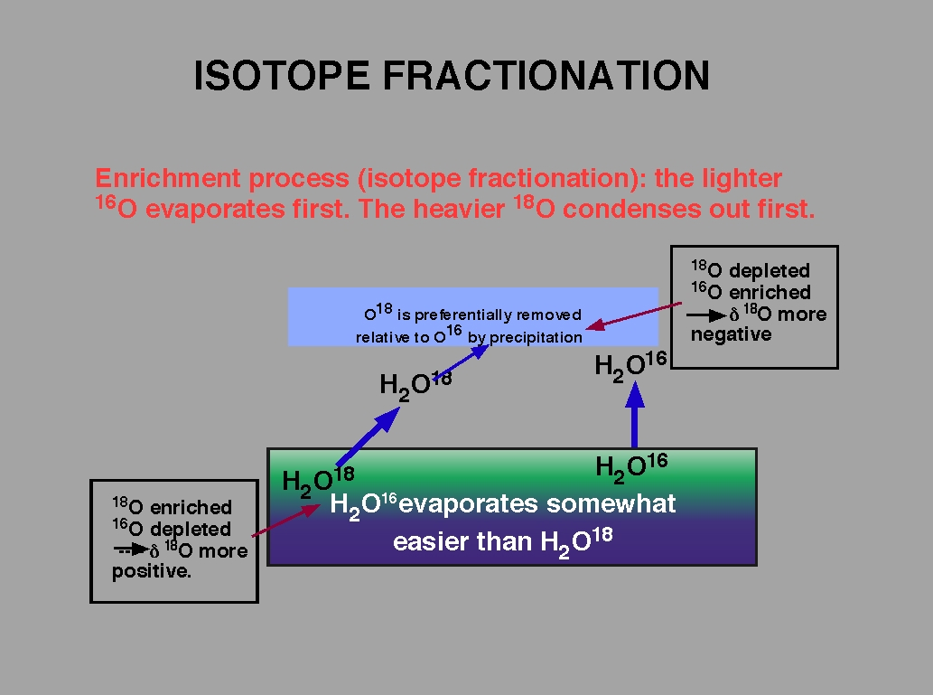

Slide 7
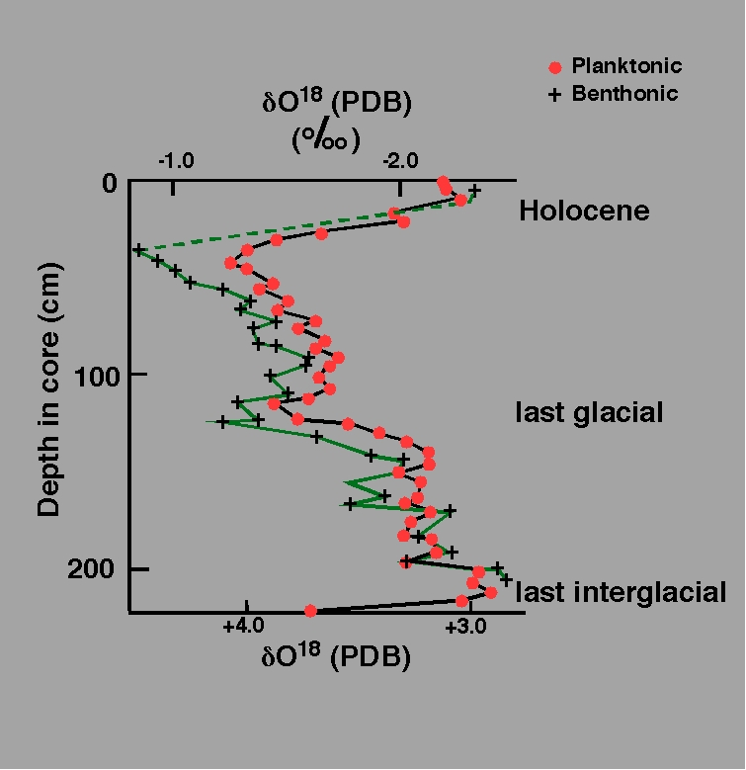
Estimation of temperature in ancient oceans
CaCO₃(s) + H₂¹⁸O ⇔ CaC¹⁸OO₂ + H₂O
The exchange of ¹⁸O between CaCO₃ and H₂O
The distribution is Temperature dependent
δ¹⁸O of planktonic & benthic foraminifera:
piston core V28-238 (160ºE 1ºN)
Planktonic and Benthic foraminifera differ due to
differences in water temperature where they grow.
Assumptions:
1. Organism ppted CaCO₃ in isotopic equilibrium
with dissolved CO₃²⁻
2. The δ¹⁸O of the original water is known
3. The δ¹⁸O of the shell has remained unchanged
Planktonic forams measure sea surface T
Benthic forams measure bottom T

Slide 8
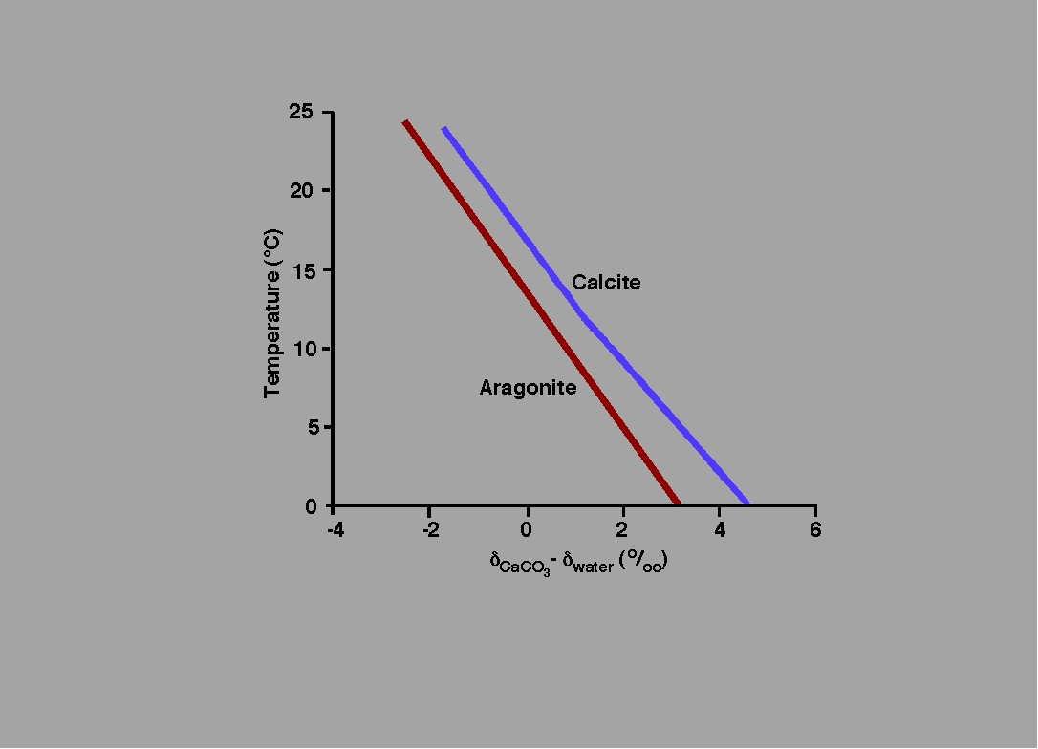
δ¹⁸O in CaCO₃ varies with Temperature
from lab experiments
Ehleringer & Hall, 1993 Fig 5.3

Slide 9
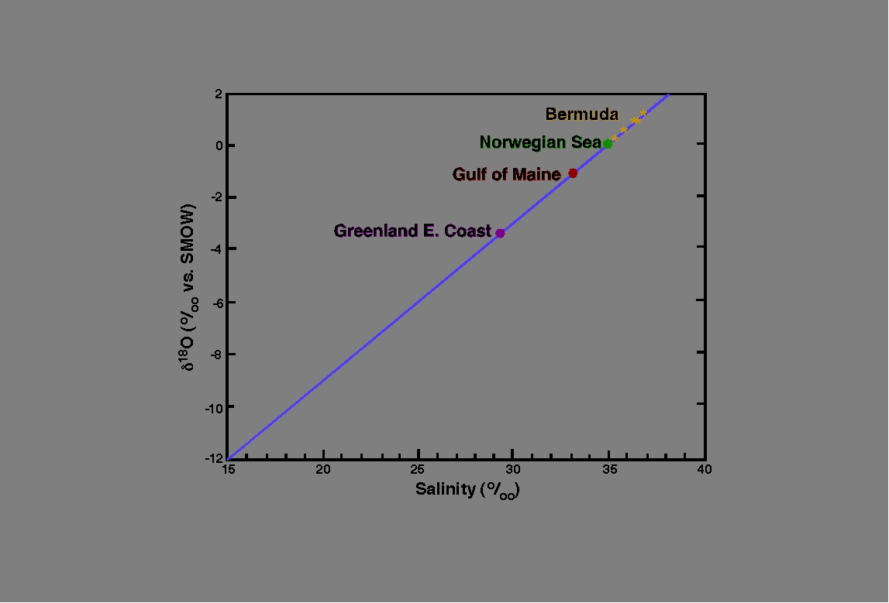
Complication: Changes in ice volume also influence δ¹⁸O
More ice = higher salinity = more δ¹⁸O left in the ocean
δ¹⁸O increases with salinity
Simplified from data in Dansgaard, 1964 & Rozanski, 1993

Slide 10
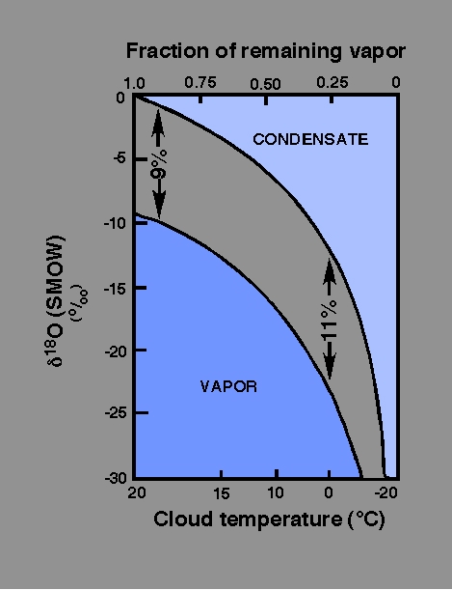
Raleigh Fractionation -
Combination of both equilibrium and kinetic isotope effects
Kinetic when water molecules evaporate from sea surface
Equilibrium effect when water molecules condense from
vapor to liquid form
Any isotope reaction carried out so that products
are isolated immediately from the reactants will show
a characteristic trend in isotopic composition.
Example: Evaporation – Condensation/
Processes
δ¹⁸O in cloud vapor and condensate (rain)
plotted versus the fraction of remaining vapor
for a Raleigh process. The isotopic composition
of the residual vapor is a function of the
fractionation factor between vapor and water
droplets. The drops are rich in ¹⁸O so the vapor
is progressively depleted in ¹⁸O .
Where R_{vapor} / R _{liquid} = f ^{(α-1)}
where f = fraction of residual vapor
α = R_{l}/R_{v}
Fractionation increases with
decreasing temperature

Slide 11
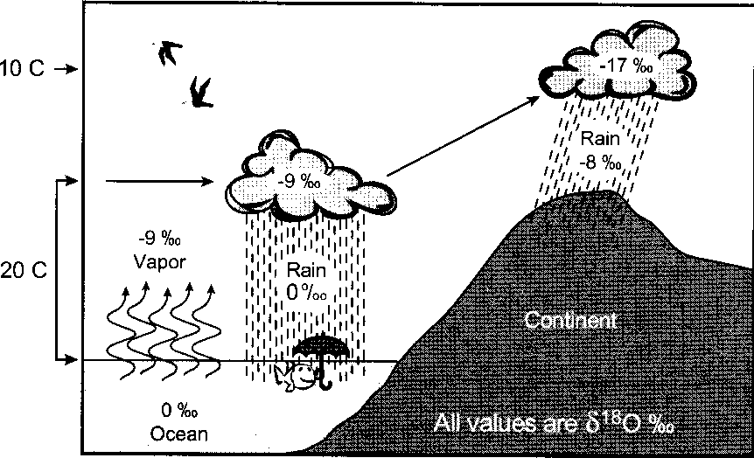
Distillation of meteoric water – large kinetic fractionation between
ocean and vapor. Rain, forming in clouds, is in equilibrium with vapor
and is heavier that the vapor. Vapor becomes progressively lighter.
δD and δ¹⁸O get lower with distance from source.
Water evaporation has a kinetic effect.
Vapor is lighter than liquid. At 20ºC the difference is 9‰ (see Raleigh plot).
Also the energy required for vaporization of H₂¹⁸O is greater than for H₂¹⁶O
Air masses transported to
higher latitudes where it is cooler.
water lost due to rain
raindrops are rich in ¹⁸O relative
to cloud.
Cloud gets lighter

Slide 12
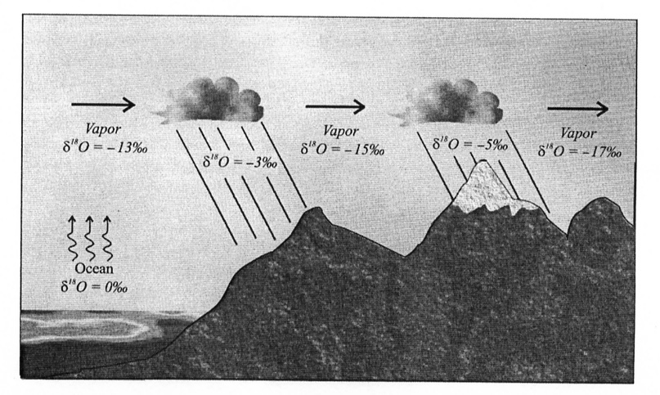
OCEANIC WATER VAPOR MODIFIED OVER LAND

Slide 13
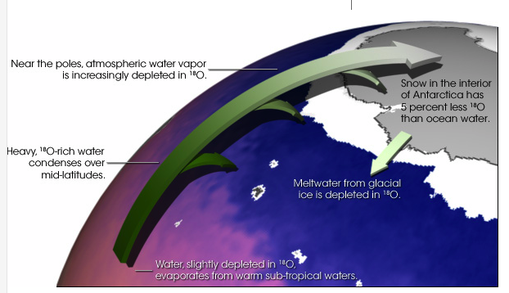
NASA, Earth Observatory, figure on-line

Slide 14
Atmosphere

Slide 15
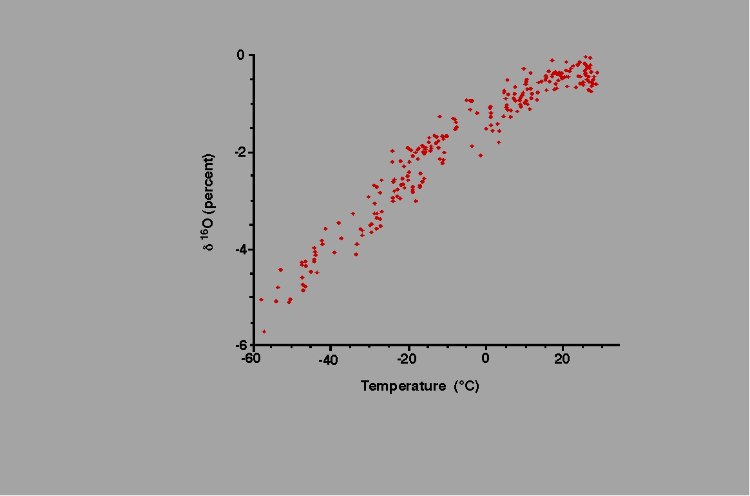
The concentration of ¹⁸O in precipitation decreases with temperature. This graph
shows the difference in ¹⁸O concentration in annual precipitation compared to the
average annual temperature at each site. The coldest sites, in locations such as
Antarctica and Greenland, have about 5 percent less ¹⁸O than ocean water.
(Graph adapted from Jouzel et. al., 1994)

Slide 16
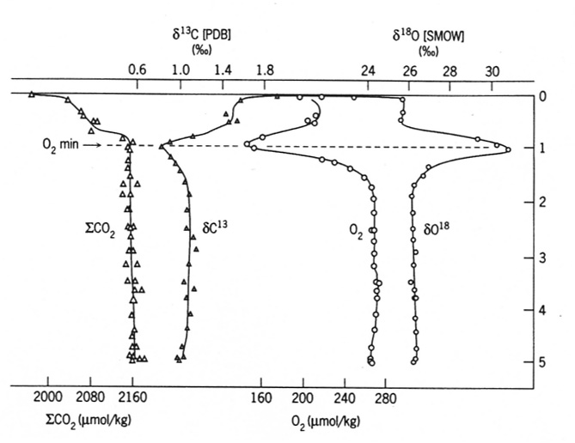
Vertical profiles of ΣCO₂, δ¹³C in DIC, O₂ and δ¹⁸O in O₂
Depth in Km
North Atlantic data

Slide 17
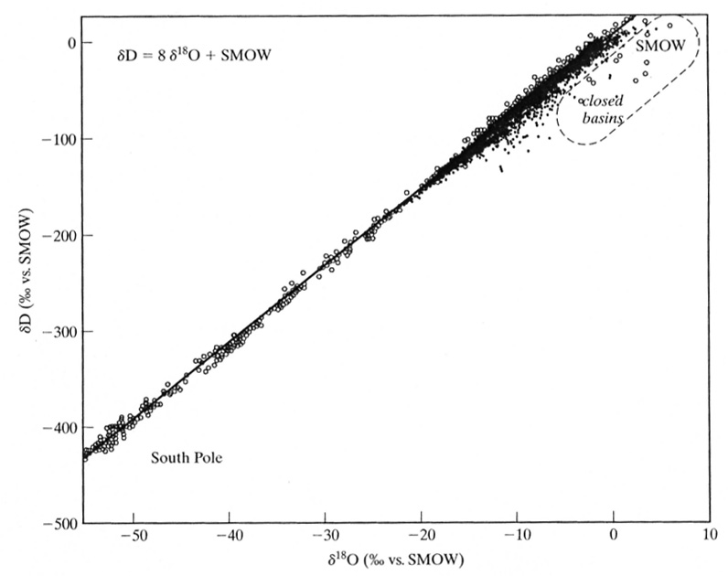
Meteoric Water Line
Linear correlation between
δD and δ¹⁸O in waters of
meteoric origin

Slide 18
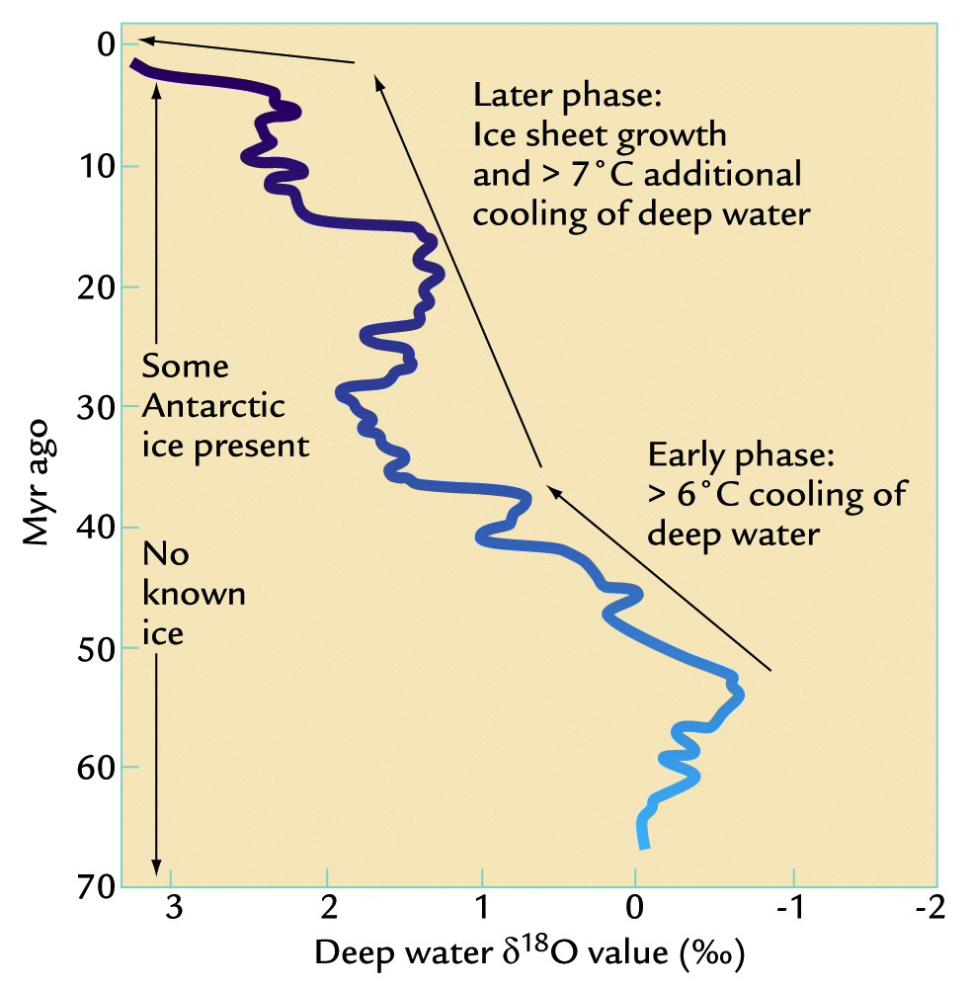
Long-term δ¹⁸O trend in the deep ocean as
measured from the calcite shells of foraminifera
Two factors:
(1) Changes in deep-
ocean temperatures
(2) Growth of ice
sheets on land
(¹⁶O enriched)

Slide 19
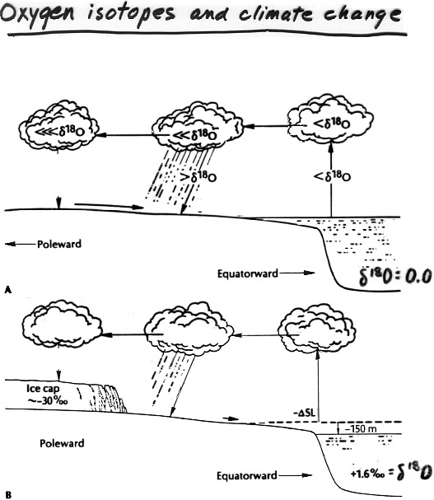
Oxygen isotope
ratios as a
thermometer
Precipitation has less
¹⁸O than ocean, why?
¹⁸O content of precipitation at the given latitude decreases with decreasing temperature.
Why?
The less ¹⁸O found in the
glacier ice, the colder the
climate.
OXYGEN ISOTOPES AND CLIMATE CHANGE
δ¹⁸O= 0.0
δ¹⁸O= 1.6º/_{oo}

